Slide 1

COMP 550
Algorithm and Analysis
Elementary Graph Algorithms
Based on CLRS Sec. 20 and
Appendix B.4

Slide 2
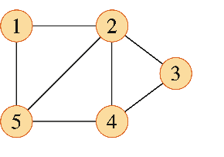
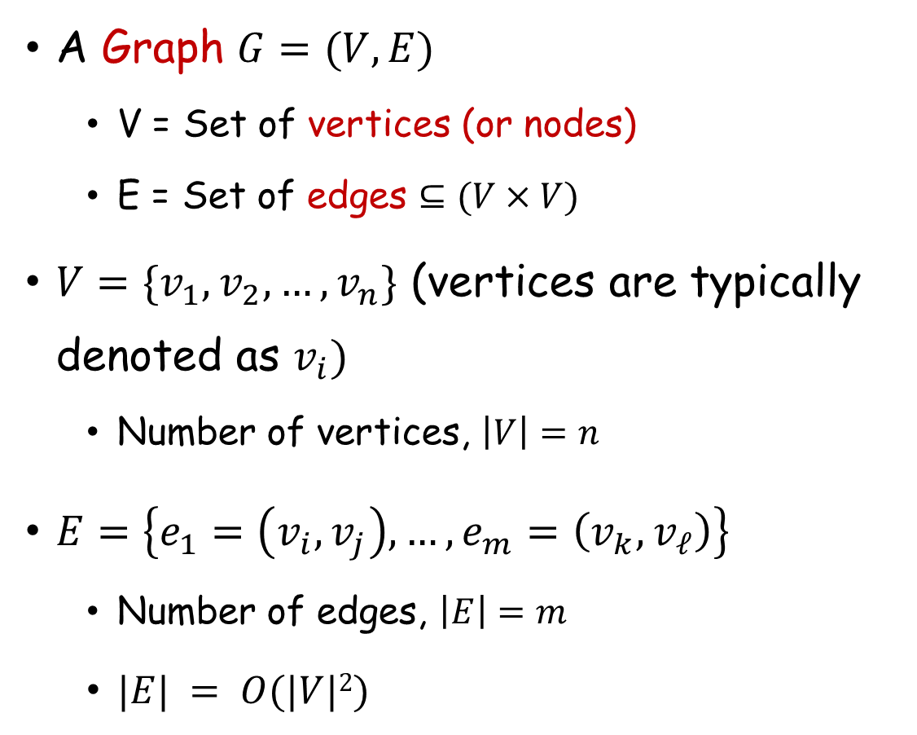
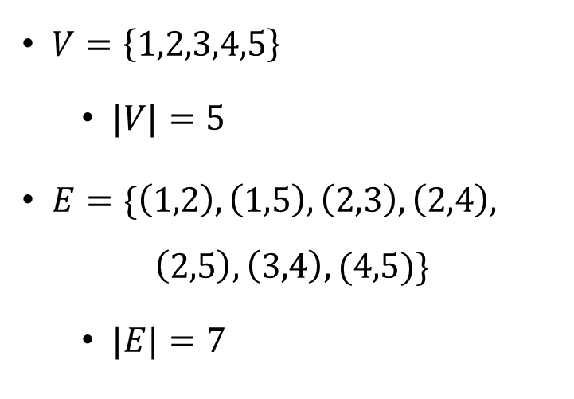
Graph: Terminology
Example:
A Graph $G=(V,E)$
  V = Set of vertices (or nodes)
  E = Set of edges $⊆(V×V)$
$V=\{v_{1},v_{2},…,v_{n}\}$ (vertices are typically denoted as $v_{i})$
  Number of vertices, $\left|V\right|=n$
$E=\left\{e_{1}=\left(v_{i},v_{j}\right),…, e_{m}=\left(v_{k},v_{ℓ}\right)\right\}$
  Number of edges, $\left|E\right|=m$
  $|E| = O(|V|2)$
$V=\left\{1,2,3,4,5\right\}$
  $|V|=5$
$E=\{\left(1,2\right), \left(1,5\right), \left(2,3\right), \left(2,4\right),$
$$\left(2,5\right),\left(3,4\right), (4,5)\}$$
  $|E|=7$

Slide 3
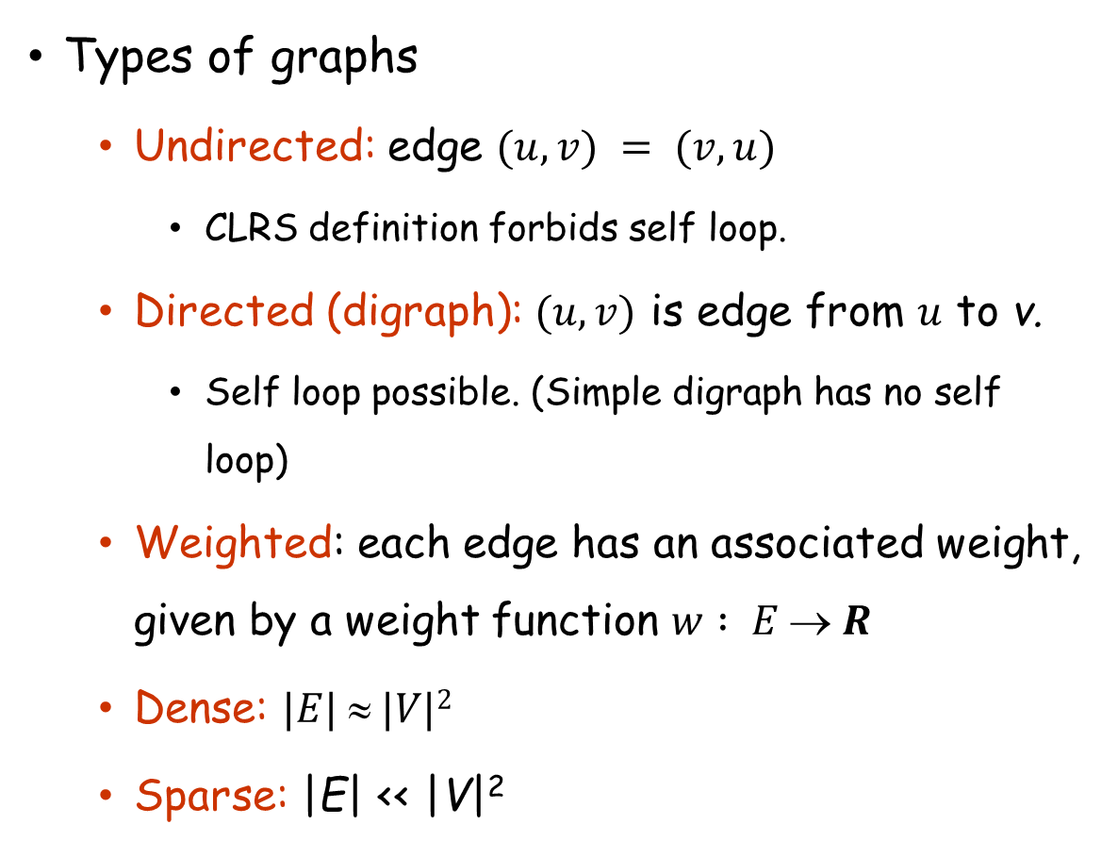
Graph: Terminology
Types of graphs
  Undirected: edge $(u, v) = (v, u)$
    CLRS definition forbids self loop.
  Directed (digraph): $(u, v)$ is edge from $u$ to v.
    Self loop possible. (Simple digraph has no self loop)
  Weighted: each edge has an associated weight, given by a weight function $w : E  R$
  Dense: $|E|  |V|2$
  Sparse: |E| << |V|²
a
b
a
b
c
d
c
d
Undirected graph
Directed graph
3
3
a
b
a
b
1
2
3
2
3
1
c
d
c
d
5
5
Weighted
undirected graph
Weighted
directed graph

Slide 4
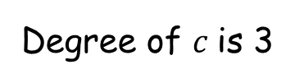
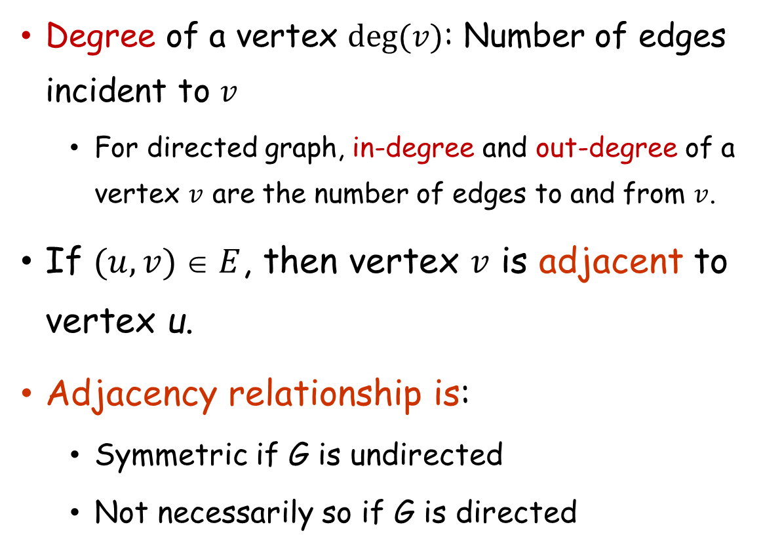

Graph: Terminology
Degree of a vertex $deg⁡(v)$: Number of edges incident to $v$
  For directed graph, in-degree and out-degree of a vertex $v$ are the number of edges to and from $v$.
If $(u, v)  E$, then vertex $v$ is adjacent to vertex u.
Adjacency relationship is:
  Symmetric if G is undirected
  Not necessarily so if G is directed
a
b
a
b
c
d
c
d
Undirected graph
Directed graph
Degree of $c$is 3
In-Degree of $c$is 1
Out-degree of $c$is 2

Slide 5
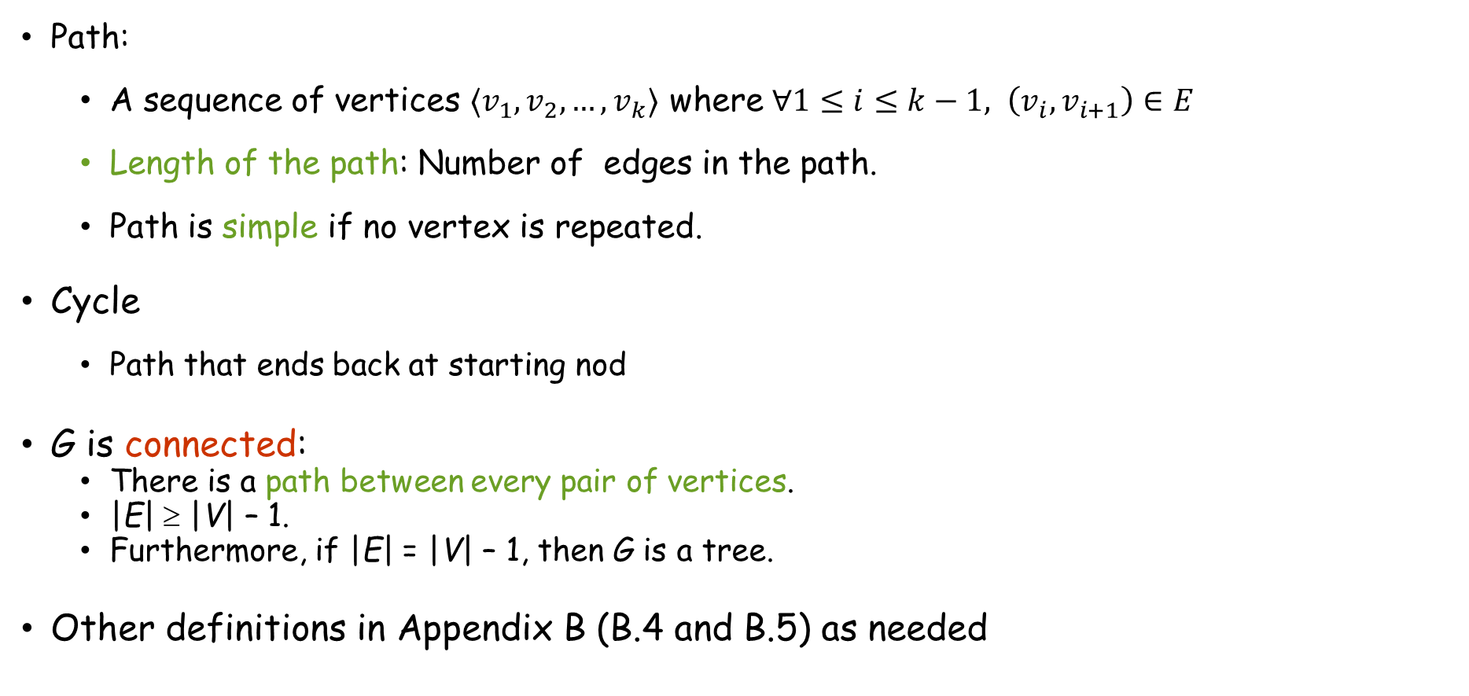

Graph: Terminology
Path:
  A sequence of vertices $⟨v_{1},v_{2},…,v_{k}⟩$ where $∀1≤i≤k−1, \left(v_{i},v_{i+1}\right)∈E$
  Length of the path: Number of edges in the path.
  Path is simple if no vertex is repeated.
Cycle
  Path that ends back at starting nod
G is connected:
  There is a path between every pair of vertices.
  |E| ≥ |V| – 1.
  Furthermore, if |E| = |V| – 1, then G is a tree.
Other definitions in Appendix B (B.4 and B.5) as needed
$⟨1,2,3⟩$ is a path
$\left\langle 1,2,5,1\right\rangle$is a cycle

Slide 6
Applications
Everywhere!
  Road or communication network
  Social media
  Protein-protein interactions
  etc.

Slide 7
Graph Representations
Two standard ways
  Adjacency Lists
  Adjacency Matrix
a
b
a
b
d
c
a
b
a
b
d
c
b
a
c
b
c
c
d
c
d
a
b
c
d
c
d
d
a
c
d
1
2
1 2 3 4
1 0 1 1 1
2 1 0 1 0
3 1 1 0 1
4 1 0 1 0
1
2
1 2 3 4
1 0 1 1 1
2 0 0 1 0
3 0 0 0 1
4 0 0 0 0
a
b
a
b
c
d
3
c
d
4
3
4

Slide 8
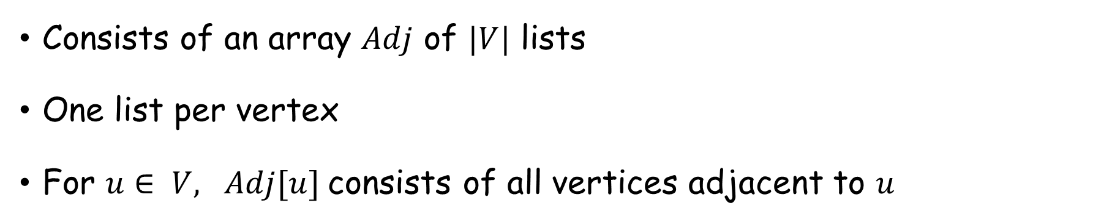
Adjacency Lists
Consists of an array $Adj$ of $|V|$ lists
One list per vertex
For $u∈ V, Adj[u]$consists of all vertices adjacent to $u$
a
b
a
b
d
c
a
b
a
b
d
c
b
a
c
b
c
c
d
c
d
a
b
c
d
c
d
d
a
c
d
If weighted, store weights also in adjacency lists

Slide 9
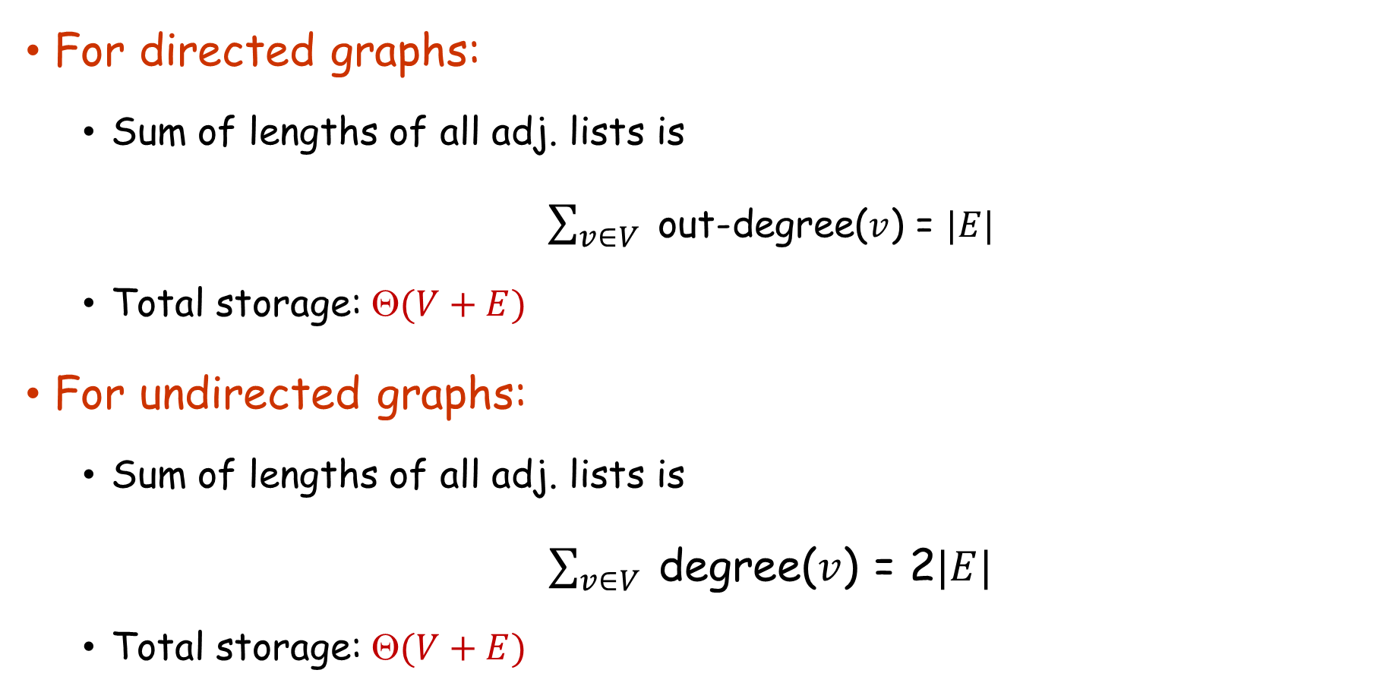
Adjacency Lists
For directed graphs:
  Sum of lengths of all adj. lists is
$\sum_{v∈V}{ }$out-degree($v$) = $|E|$
  Total storage: $(V+E)$
For undirected graphs:
  Sum of lengths of all adj. lists is
$\sum_{v∈V}{ }$degree($v$) = 2$|E|$
  Total storage: $(V+E)$

Slide 10
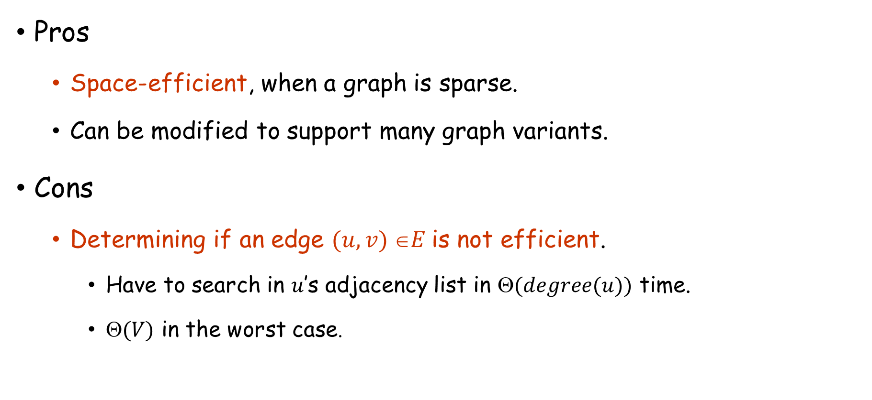
Adjacency Lists
Pros
  Space-efficient, when a graph is sparse.
  Can be modified to support many graph variants.
Cons
  Determining if an edge $(u,v) E$is not efficient.
    Have to search in $u$’s adjacency list in $(degree(u))$ time.
    $(V)$ in the worst case.

Slide 11
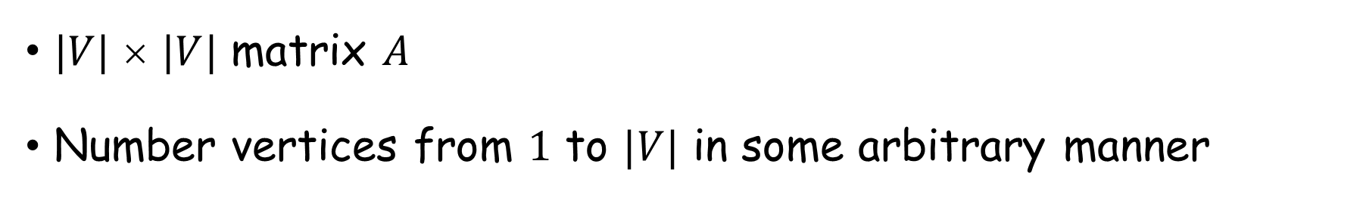
Adjacency Matrix
$|V|$ × $|V|$ matrix $A$
Number vertices from $1$ to $|V|$ in some arbitrary manner
1
2
1 2 3 4
1 0 1 1 1
2 1 0 1 0
3 1 1 0 1
4 1 0 1 0
1
2
1 2 3 4
1 0 1 1 1
2 0 0 1 0
3 0 0 0 1
4 0 0 0 0
a
b
a
b
c
d
3
c
d
4
3
4

Slide 12
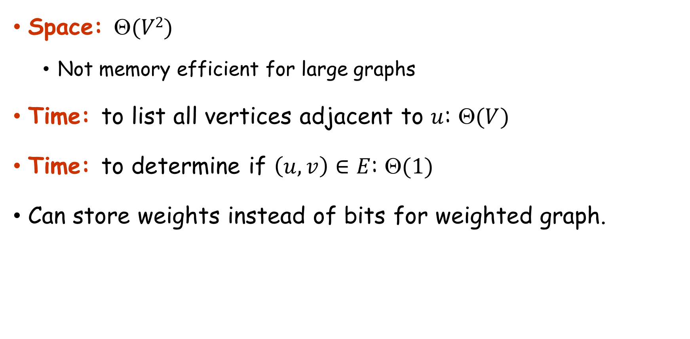
Adjacency Matrix
Space: $(V2)$
  Not memory efficient for large graphs
Time: to list all vertices adjacent to $u$: $(V)$
Time: to determine if $\left(u, v\right)∈E$: $(1)$
Can store weights instead of bits for weighted graph.

Slide 13
Graph Search
Searching a graph:
  Systematically follow the edges of a graph to visit the vertices of the graph
Used to discover the structure of a graph
Standard graph-searching algorithms
  Breadth-first Search (BFS)
  Depth-first Search (DFS)

Slide 14

Breadth-First Search (BFS)
Given a graph $G = \left(V,E\right)$ and a source vertex $s$, want to discover vertices reachable from $s$ and their shortest path distance from $s$
Input: Graph $G = (V, E),$either directed or undirected, and a source vertex $s∈ V$
Output:
  $v.d =$distance (smallest # of edges, or shortest path) from $s$ to $v$, for all $v∈V$. $v.d =∞$if $v$ is not reachable from $s$.
  $v. = u$ such that $(u, v)$ is last edge on shortest path $s v$
    $u$ is $v$’s predecessor.
  Builds breadth-first tree with root $s$ that contains all reachable vertices

Slide 15



Breadth-First Search (BFS)
We want our search algorithm to produce shortest distance from $s$ to $v$ for all $v$.
Idea:
  Notation: Shortest-path distance from $s$ to $v$ is $δ(s,v)$
  If $δ\left(s,v\right)=x≥1$, then there is a vertex $u$ with $δ\left(s,u\right)=x−1$
  We want to discover $v$ via $u$
$$x−1$$
s
u
v
$$x$$

Slide 16
Breadth-First Search (BFS)
Expands the frontier between discovered and undiscovered vertices uniformly across the breadth of the frontier.
  A vertex is “discovered” the first time it is encountered during the search.
  A vertex is “finished” if all vertices adjacent to it have been discovered.
Colors the vertices to keep track of progress.
  White – Undiscovered.
  Gray – Discovered but not finished.
  Black – Finished.
  Colors are basically different numbers/characters
  Colors are also not required
2
2
2
2
S
2
2
Finished
Discovered
Undiscovered

Slide 17
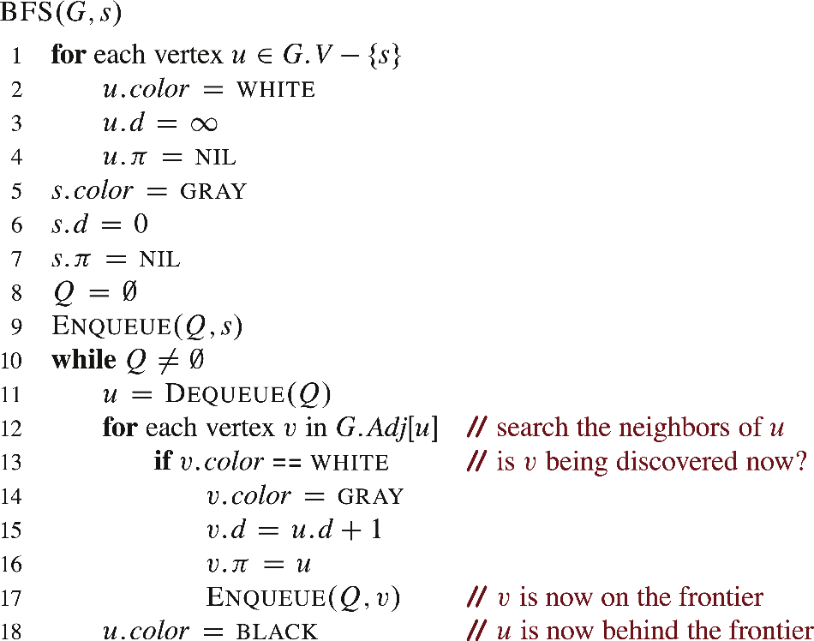
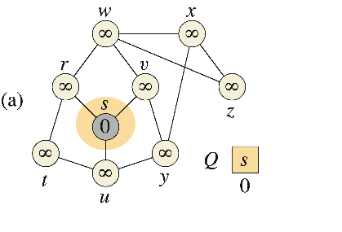
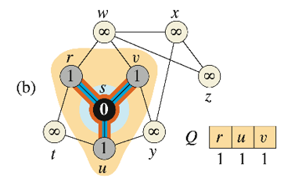

Breadth-First Search (BFS)
i) Dequeue $s$, ii) Enqueue $s$’s undiscovered neighbors $\{r,v,u\}$, make then gray, and update their $d$ and $π$, iii) Make $s$black
Q holds discovered by unfinished vertices (gray vertices).

Slide 18
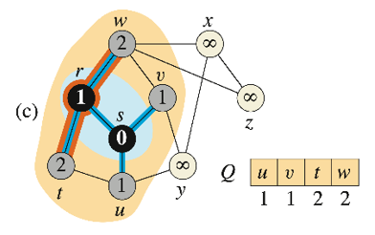

Breadth-First Search (BFS)
i) Dequeue $r$, ii) Enqueue $r$’s undiscovered neighbors $\{t,w\}$, make then gray, and update their $d$ and $π$, iii) Make $r$black
Q holds discovered by unfinished vertices (gray vertices).

Slide 19
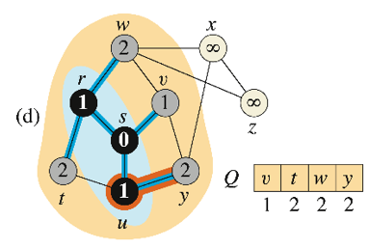

Breadth-First Search (BFS)
i) Dequeue $u$, ii) Enqueue $u$’s undiscovered neighbors $\{y\}$, make then gray, and update their $d$ and $π$, iii) Make $u$black
Q holds discovered by unfinished vertices (gray vertices).

Slide 20
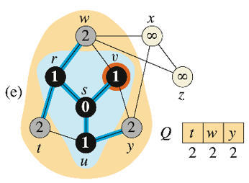

Breadth-First Search (BFS)
i) Dequeue $v$, ii) Enqueue $v$’s undiscovered neighbors (None), make then gray, and update their $d$ and $π$, iii) Make $v$black
Q holds discovered by unfinished vertices (gray vertices).

Slide 21
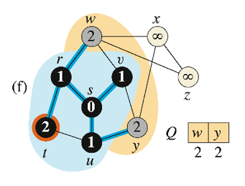

Breadth-First Search (BFS)
i) Dequeue $t$, ii) Enqueue $t$’s undiscovered neighbors (None), make then gray, and update their $d$ and $π$, iii) Make $t$black
Q holds discovered by unfinished vertices (gray vertices).

Slide 22
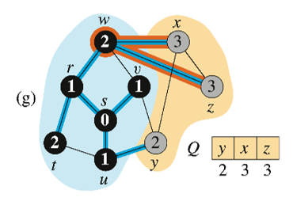

Breadth-First Search (BFS)
i) Dequeue $w$, ii) Enqueue $w$’s undiscovered neighbors $\{x,z\}$, make then gray, and update their $d$ and $π$, iii) Make $w$black
Q holds discovered by unfinished vertices (gray vertices).

Slide 23
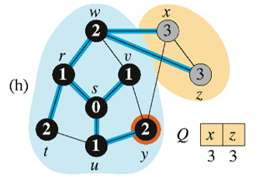

Breadth-First Search (BFS)
i) Dequeue $y$, ii) Enqueue $y$’s undiscovered neighbors (None), make then gray, and update their $d$ and $π$, iii) Make $y$black
Q holds discovered by unfinished vertices (gray vertices).

Slide 24
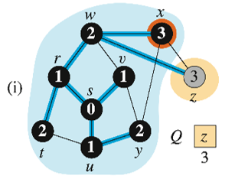

Breadth-First Search (BFS)
i) Dequeue $x$, ii) Enqueue $x$’s undiscovered neighbors (None), make then gray, and update their $d$ and $π$, iii) Make $x$black
Q holds discovered by unfinished vertices (gray vertices).

Slide 25
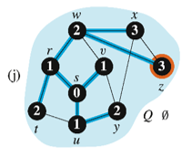

Breadth-First Search (BFS)
i) Dequeue $z$, ii) Enqueue $z$’s undiscovered neighbors (None), make then gray, and update their $d$ and $π$, iii) Make $z$black
Q holds discovered by unfinished vertices (gray vertices).

Slide 26
Breadth-First Search (BFS)
BFS tree formed by blue edges
Q holds discovered by unfinished vertices (gray vertices).

Slide 27
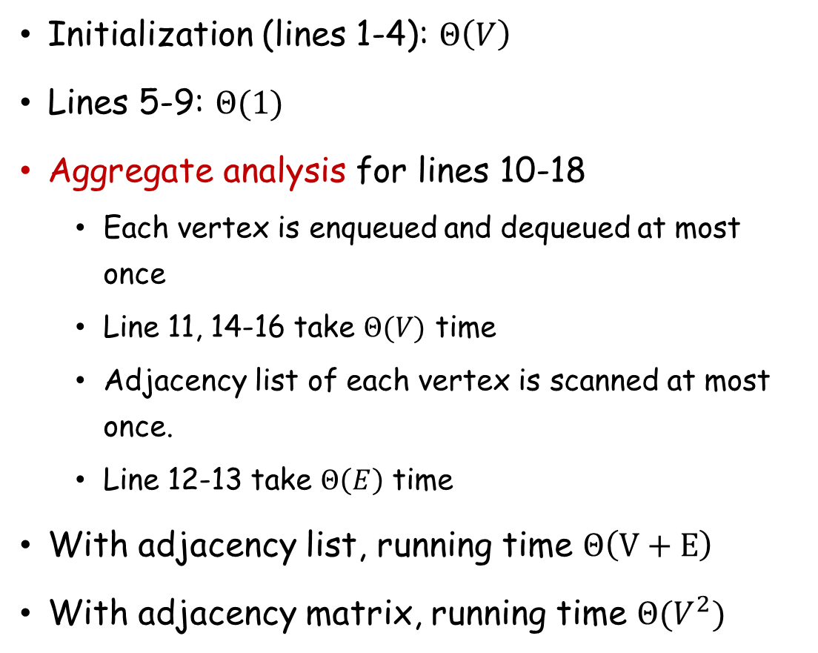
BFS Time Complexity
Initialization (lines 1-4): $Θ\left(V\right)$
Lines 5-9: $Θ(1)$
Aggregate analysis for lines 10-18
  Each vertex is enqueued and dequeued at most once
  Line 11, 14-16 take $Θ(V)$ time
  Adjacency list of each vertex is scanned at most once.
  Line 12-13 take $Θ\left(E\right)$ time
With adjacency list, running time $Θ\left(V+E\right)$
With adjacency matrix, running time $Θ(V^{2})$

Slide 28
Depth-First Search (DFS)
Explore edges out of the most recently discovered vertex v.
When all edges of v have been explored, backtrack to explore other edges leaving the vertex from which v was discovered (its predecessor).
“Search as deep as possible first.”
Continue until all vertices reachable from the original source are discovered.
If any undiscovered vertices remain, then one of them is chosen as a new source and search is repeated from that source.

Slide 29
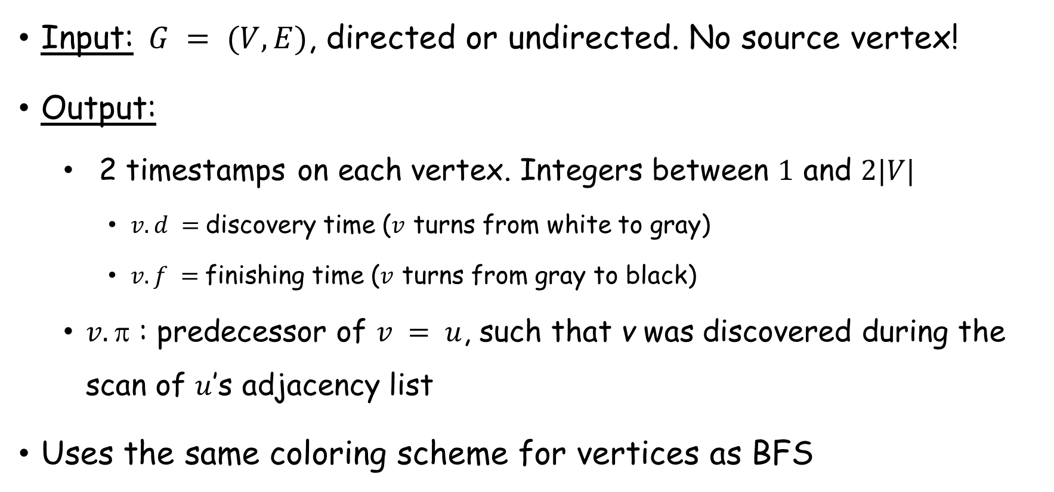
Depth-First Search (DFS)
Input: $G = (V, E)$, directed or undirected. No source vertex!
Output:
  2 timestamps on each vertex. Integers between $1$ and $2|V|$
    $v.d =$discovery time ($v$ turns from white to gray)
    $v.f =$finishing time ($v$ turns from gray to black)
  $v.$ : predecessor of $v = u$, such that v was discovered during the scan of $u$’s adjacency list
Uses the same coloring scheme for vertices as BFS

Slide 30
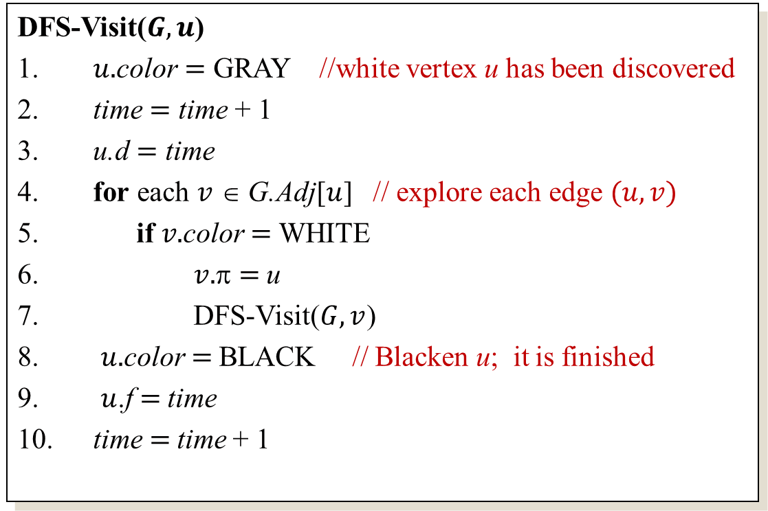
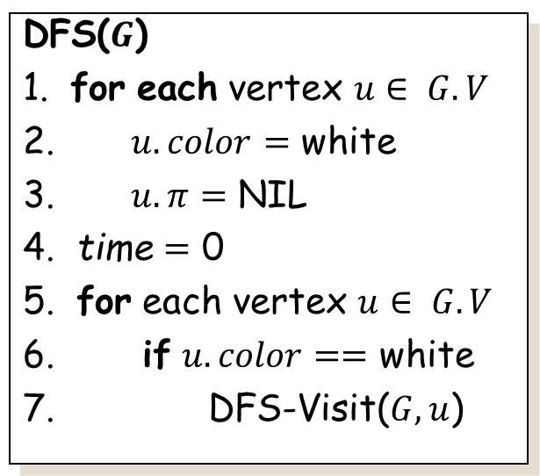
Depth-First Search (DFS)
DFS($G$)
1. for each vertex $u∈ G.V$
2. $u.color$ $=$ white
3. $u.π$ $=$ NIL
4. time $=$ 0
5. for each vertex $u∈ G.V$
6. if $u.color==$ white
7. DFS-Visit($G,u$)
DFS-Visit($G,u$)
$u.$color $=$ GRAY //white vertex u has been discovered
time $=$ time + 1
u.d $=$ time
for each $v$ ∈ G.Adj[$u$] // explore each edge $(u,v)$
if $v.$color $=$ WHITE
$v.$π $=$u
DFS-Visit($G,v$)
$u.$color $=$BLACK // Blacken u; it is finished
$u$.f$=$ time
time$=$time + 1
Uses a global timestamp time.

Slide 31
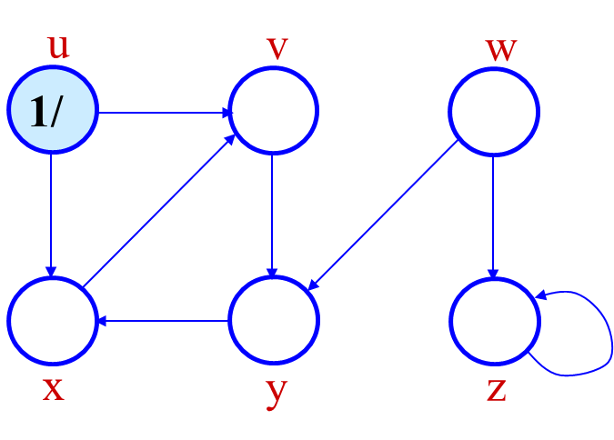
Depth-First Search (DFS)
(Courtesy of Prof. Jim Anderson)

Slide 32
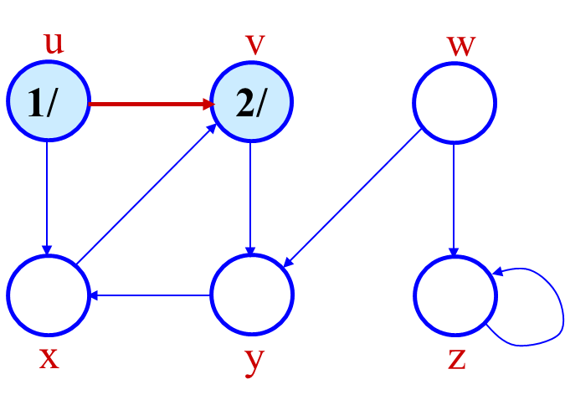
Depth-First Search (DFS)

Slide 33
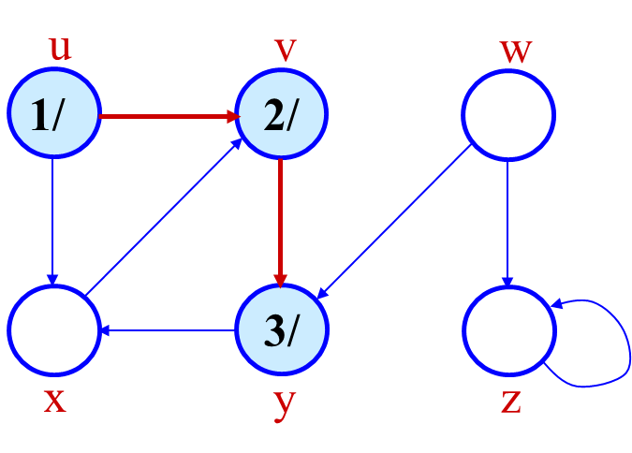
Depth-First Search (DFS)

Slide 34
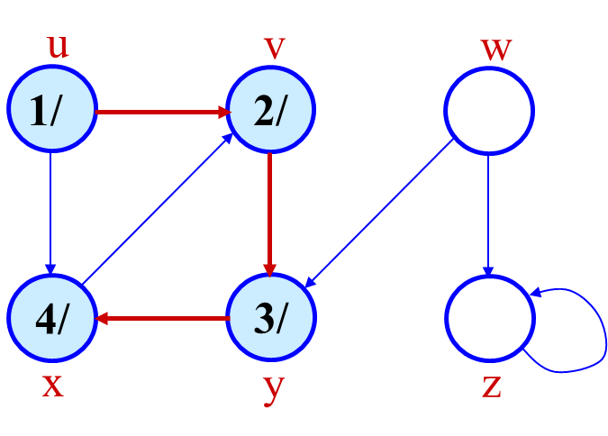
Depth-First Search (DFS)

Slide 35

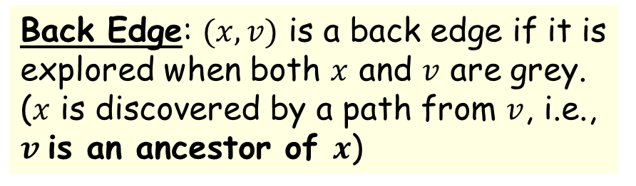
Depth-First Search (DFS)
Back Edge: $(x,v)$ is a back edge if it is explored when both $x$ and $v$ are grey.
($x$ is discovered by a path from $v$, i.e., $v$is an ancestor of $x$)

Slide 36
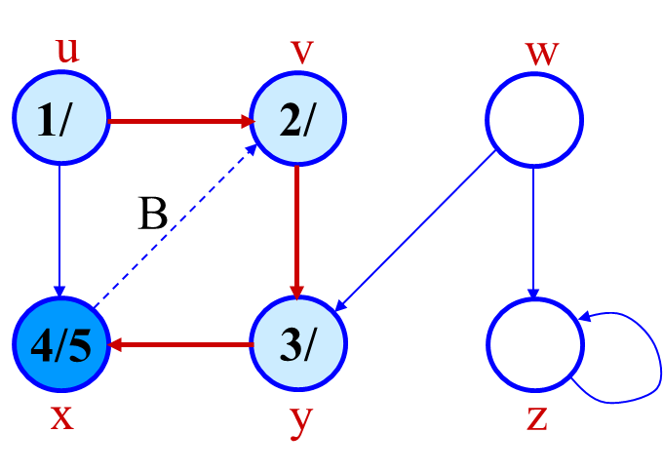
Depth-First Search (DFS)

Slide 37
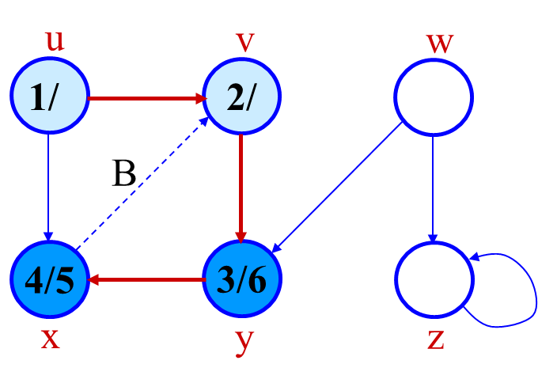
Depth-First Search (DFS)

Slide 38
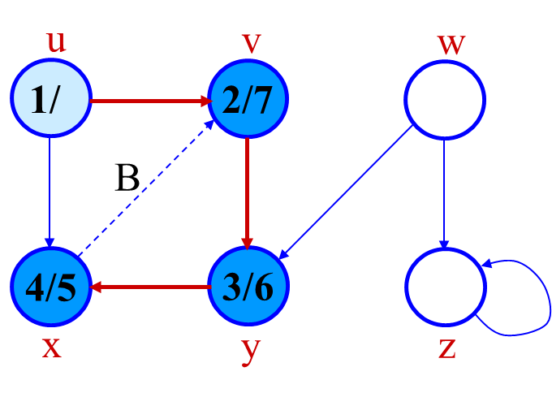
Depth-First Search (DFS)

Slide 39
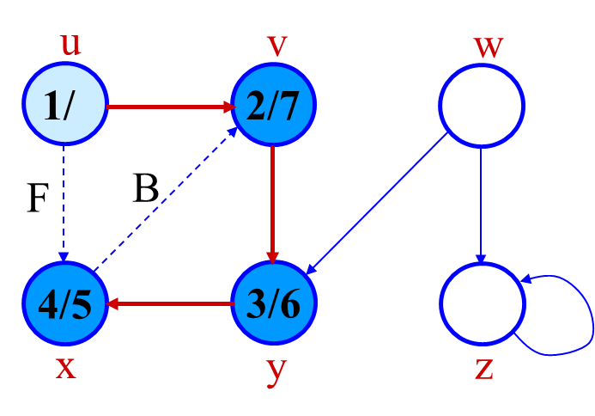
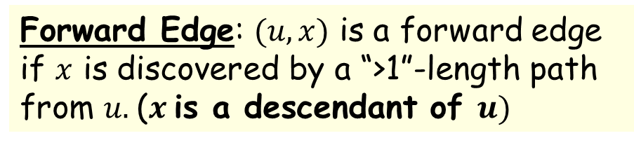
Depth-First Search (DFS)
Forward Edge: $(u,x)$ is a forward edge if $x$ is discovered by a “>1”-length path from $u.$($x$is a descendant of $u)$

Slide 40
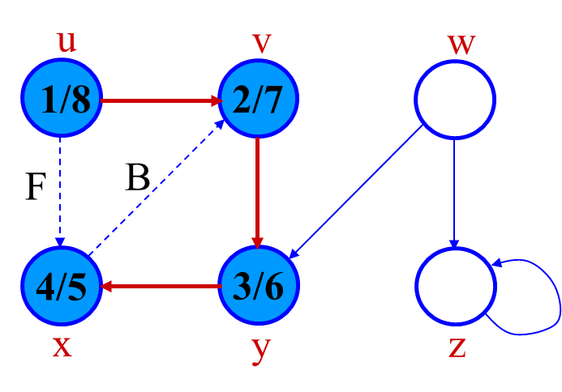
Depth-First Search (DFS)

Slide 41
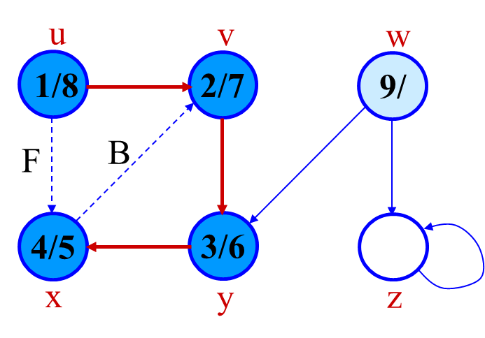
Depth-First Search (DFS)

Slide 42


Depth-First Search (DFS)
Cross Edge: $(w,y)$ is a back edge if no ancestor descendant relationships between them.

Slide 43
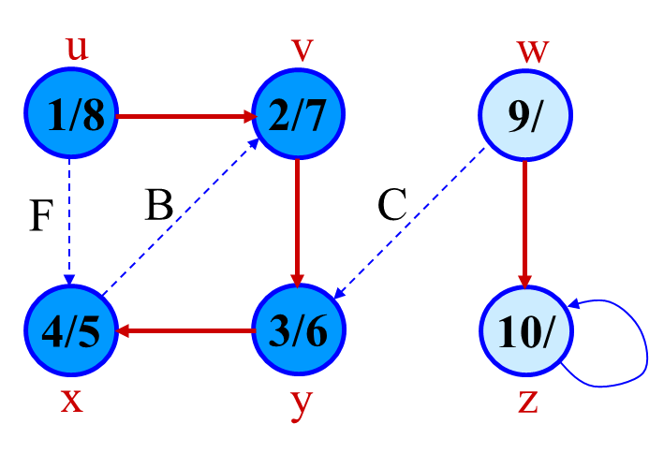
Depth-First Search (DFS)

Slide 44
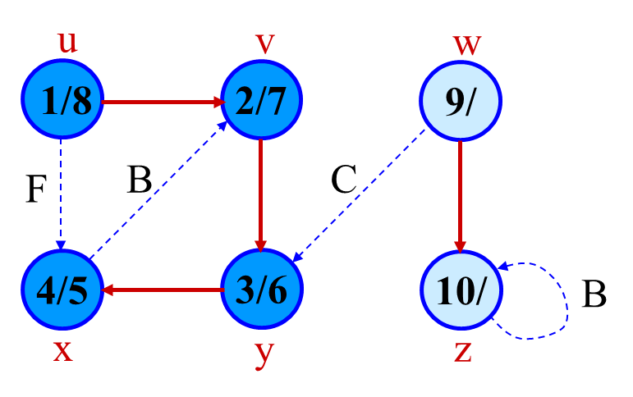
Depth-First Search (DFS)

Slide 45
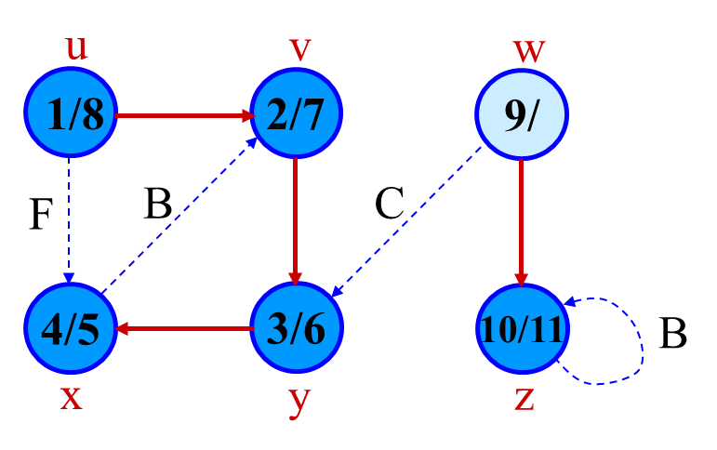
Depth-First Search (DFS)
Self loops are considered as back edge

Slide 46
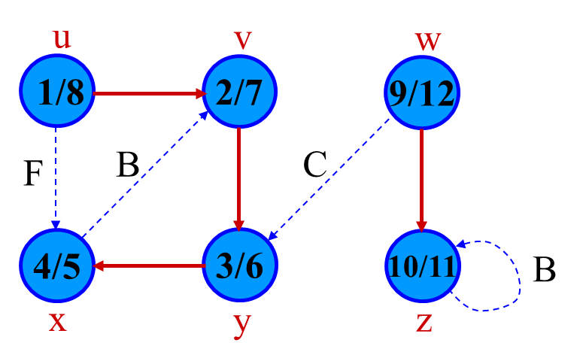
Depth-First Search (DFS)

Slide 47
Depth-First Forest
DFS creates a forest (subgraph induced by the red edges in the example)
  Forest: An acyclic graph G that may be disconnected. (G has multiple trees)
Tree edge: Edges in the forest
  Edge that discovers new vertices
Recall:
  Back edge: edge from a descendant to an ancestor
  Forward edge: edge from ancestor to a proper descendant
u
v
w
1/8
2/7
9/12
F
B
C
4/5
3/6
10/11
B
x
y
z

Slide 48
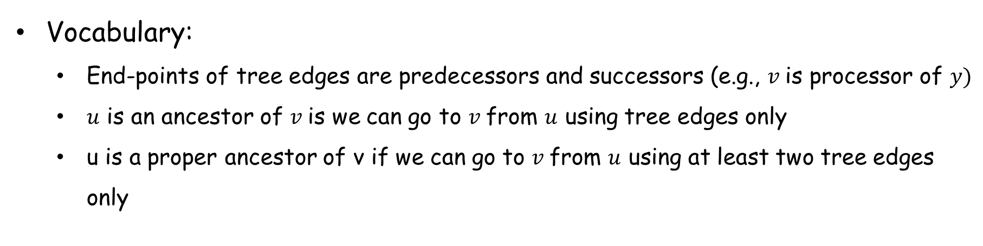
Depth-First Forest
u
v
w
Recall:
  Back edge: edge from a descendant to an ancestor
  Forward edge: edge from ancestor to a proper descendant
  Cross edge: no ancestor descendant relationship
1/8
2/7
9/12
F
B
C
4/5
3/6
10/11
B
x
y
z
Vocabulary:
  End-points of tree edges are predecessors and successors (e.g., $v$is processor of $y)$
  $u$ is an ancestor of $v$is we can go to $v$from $u$ using tree edges only
  u is a proper ancestor of v if we can go to $v$from $u$ using at least two tree edges only

Slide 49
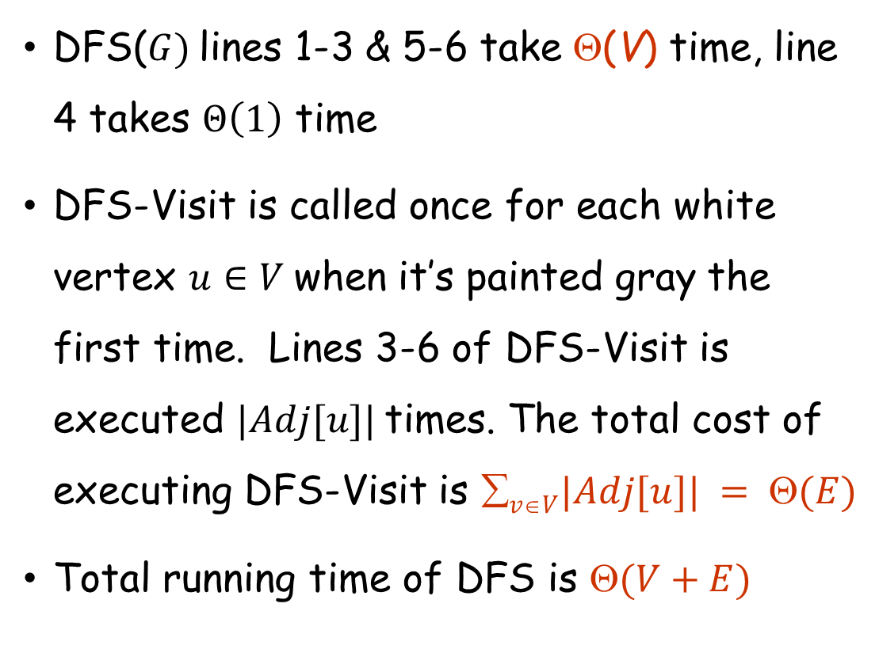
Depth-First Search (DFS)
DFS($G)$lines 1-3 & 5-6 take Θ(V) time, line 4 takes $Θ\left(1\right)$ time
DFS-Visit is called once for each white vertex $u∈V$when it’s painted gray the first time. Lines 3-6 of DFS-Visit is executed $|Adj[u]|$times. The total cost of executing DFS-Visit is $vV|Adj[u]| = (E)$
Total running time of DFS is $(V+E)$

Slide 50
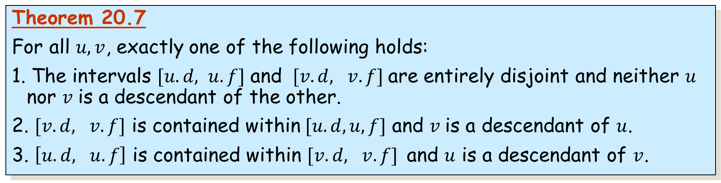
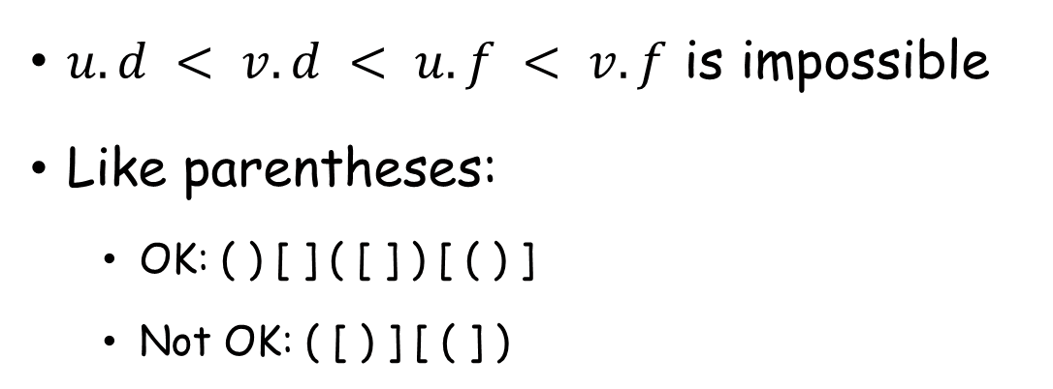
Parentheses Theorem
Theorem 20.7
For all $u, v$, exactly one of the following holds:
1. The intervals $[u.d, u.f]$ and $[v.d, v.f]$are entirely disjoint and neither $u$ nor $v$ is a descendant of the other.
2. $[v.d, v.f]$ is contained within$[u.d, u,f]$ and $v$ is a descendant of $u$.
3. $\left[u.d, u.f\right]$ is contained within $[v.d, v.f]$and $u$ is a descendant of $v$.
$u.d < v.d < u.f < v.f$ is impossible
Like parentheses:
  OK: ( ) [ ] ( [ ] ) [ ( ) ]
  Not OK: ( [ ) ] [ ( ] )

Slide 51
Parentheses Theorem
(u (v (y (x x) y) v u) (w (z z) w)

Slide 52



Topological Sorting
Directed Acyclic Graph (DAG): directed graph with no cycle
  Can be used to model dependency relationship
Topological Sort: Ordering of vertices of a DAG so that for any edge $\left(u,v\right),$ $u$ appears before $v$ in the ordering
u
v
w
w
z
u
v
y
x
x
y
z

Slide 53




Topological Sorting
Topological Sort: Ordering of vertices of a DAG so that for any edge $\left(u,v\right),$ $u$ appears before $v$ in the ordering

Slide 54
Thank You!

